Slide 1


Robinson Rivas Suárez
Universidad Central de Venezuela
INTRODUCTION TO OpenMP
Prof. Robinson Rivas-Suárez
UNIVERSIDAD CENTRAL DE VENEZUELA

Slide 2
Robinson
BsC in Computer Science (Maracaibo, Venezuela)
Master in Computer Science (Caracas, Venezuela)
Network Engineer (OIC, Japan)

Slide 3
Overview
In this tutorial we will discuss OpenMP, the de facto standard for Shared Memory architectures
There is a lot of good material over the Internet. We suggest to follow the OpenMP Consortium official releases
For this presentation, we used Intel public material
OpenMP can be run and tested from almost any desktop device, using Windows, Linux or Mac based Operating Systems, as well as they have gcc compiler
Please read the material before making exercises!

Slide 4
Overview
That’s really necessary?
Why to think about shared memory
OpenMP and new models of programming
Everyday platforms
New trends

Slide 5
Back to school
Often, we professors teach our students that algorithms must be designed, planned and then programmed as much abstract as possible, i.e. only thinking on the problem to be solved rather than the computer that actually solves it.
This way of thinking is so-called abstract design

Slide 6
Real World
In modern life, however, technical and physical details drives to different ways to implement the same idea due to hardware constraints
In this dissertation, I will present two different such ways, based on deep differences between architectural schemas

Slide 7
An opinion
People who are more than casually interested in computers should have at least some idea of what the underlying hardware is like. Otherwise the programs they write will be pretty weird
― Donald Knuth,
The Art of Computer Programming,
Volume 1: Fundamental Algorithms

Slide 8
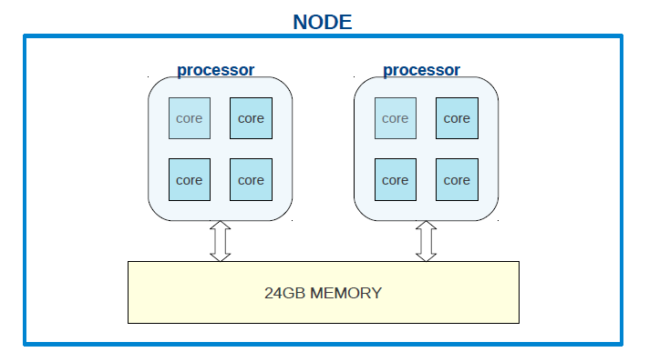
Shared Memory
More than two processors using the same memory system, at least parts of the same memory system
It happens when there are many cores per processor. It was rare in the very early years, but it is really common today

Slide 9
Practical question
Can you say how many processors have the computer you are using?
How many cores have the phone you own?

Slide 10
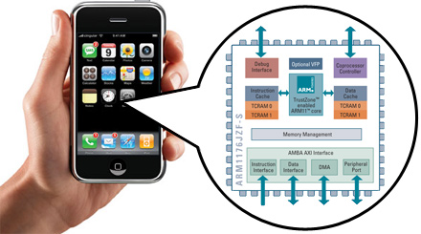
Shared Memory
Think in a standard smartphone today. Tipically, ARM processors have 4 cores (even more)
So, computers we have in our pockets needs to be programmed in an efficient yet reliable way
HPC in terms of shared
memory is not just for top
500 list supercomputers
… it matters everywhere!!

Slide 11

OpenMP
OpenMP is an standard set of instructions available for the most important HPC programming languages
It was originally proposed as an open specification in 1996
First official draft of the
OpenMP consortium was
released in 1997
OpenMP is managed by the nonprofit technology consortium OpenMP Architecture Review Board (or OpenMP ARB), jointly defined by a group of major computer hardware and software vendors, including AMD, IBM, Intel, Cray, HP, Fujitsu, Nvidia, NEC, Red Hat, Texas Instruments, Oracle Corporation, and more. source: Wikipedia

Slide 12

Http://www.openmp.org

Slide 13

Advantages of OpenMP
Portability: code runs in any platform, since thread creation is encapsulated inside the actual O.S.
Programmer has not to control the thread behavior. It releases him/her from the heaviest part of thread management
Because is intended to work in shared memory, OpenMP does not deal with message passing. It eliminates the most common source of errors in parallel programming

Slide 14

Advantages of OpenMP
Higly scalable: performance usually goes better when code is executed in more cores
By design, OpenMP permits to keep the sequential code as it is. It allows to use the programs in different environments without need to recompile (on the same architecture)

Slide 15

Scalability
This advantage is not universal.
  Some times, having a big number of threads available could lead to slower programs
  Some times, having more threads than actual cores could lead to faster programs
  Can you think in such scenarios?

Slide 16

OpenMP issues
Debugging process is not that easy. OpenMP doesn’t have an efficient native error handling mechanism
By now, internal details of threads are hidden for programmer. It is of course an advantage for readyness and portability, but doesn’t allow programmers to do fine control to improve performance on specific architectures

Slide 17
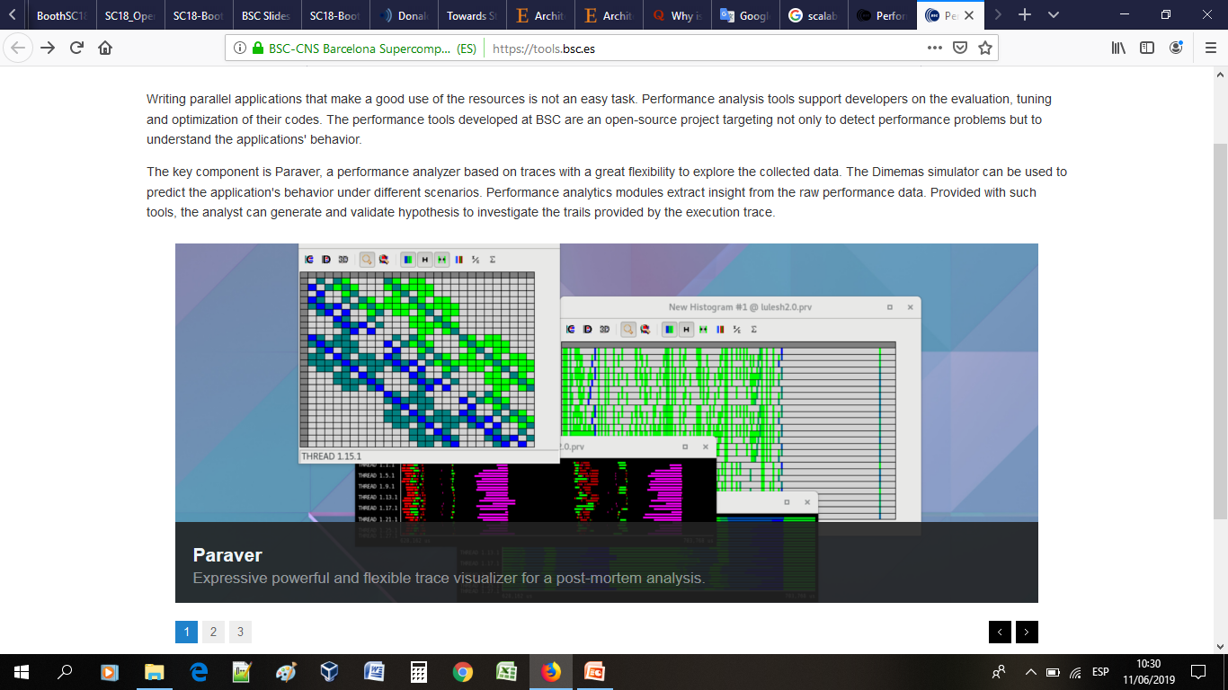
OpenMP issues
Many tools has being designed to help with this. But are not part of the standard itself.
Some examples are profilers like Valgrind, VAMPIR, SCORE-P, etc
BSC (Barcelona-Spain)has developed a few useful tools to help better understanding of OpenMP parallel code

Slide 18
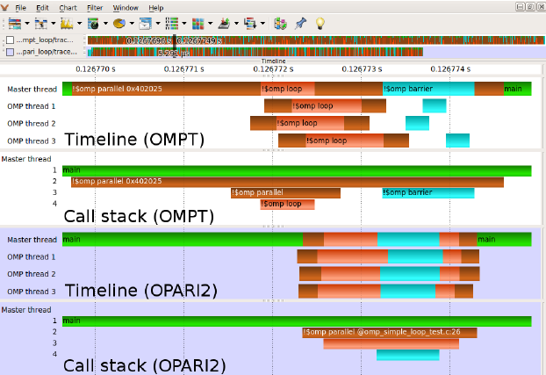
OpenMP issues
OMPT (OpenMP Tools Special Working Group) and OPARI2 (Jülich Research, U. of Oregon) were designed to serve as tools to achieve runtime OpenMP indicators
i.e., OpenMP community is dynamic and active
A Comparison between OPARI2 and the OpenMP Tools Interface in the Context of Score-P
September 2014

Slide 19
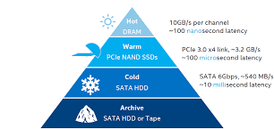
OpenMP issues
OpenMP doesn’t have memory-related instructions. You can’t deal with cache, memory layers or new architecture models. Everything is seem as plain shared memory (*)
Startup time for threads is high compared to sequential time for execution. So, if the problem is really small, OpenMP parallel version could be worst than sequential version
(*) we’ll be back about this later

Slide 20

what OpenMP doesn’t is …
OpenMP is designed as a series of compiler directives plus an small suite of library functions. So:
OpenMP is NOT a library nor a set of pre-compiled code
OpenMP is NOT designed to run well in a distributed-memory environment

Slide 21
what OpenMP doesn’t is …
OpenMP is NOT a programming language, so you have not to learn new instructions (not so much new instructions)
OpenMP does not solve your problems with parallel code generation. For instance, it doesn’t partition data in any way but array splitting, so you must take care of data structures

Slide 22
WARNING
“Premature optimization
is the root of all evil.”
― Donald Knuth,
The Art of Computer Programming,
Volume 1: Fundamental Algorithms

Slide 23
Example 1
#include <stdio.h>
int main(char **argv,int argc)
{
#pragma omp parallel
printf(“Salve, mundi\n”); //Hello world in latin ;-)
exit (0);
}

Slide 24
How to connect

Slide 25
How to try for SC-Campers
SSH with your favourite client
  ssh -l student_X toctoc.sc3.uis.edu.co
  Password: sC3_2o25%
Then:
  ssh guane
Toctoc is spanish version of knock knock ;-) just an entry point
Guane is the “real” cluster. Luis Alejandro will explain in detail later

Slide 26

Compiling & running
Compile:
#gcc -fopenmp hello.c –o hello
In general: gcc –fopenmp {source.c}
options -o executable
Run:
#export OMP_NUM_THREADS=4
#./hello

Slide 27
Example 1
Compile & run this code with 2,4 and 8 threads
#include <stdio.h>
int main(char **argv,int argc)
{
#pragma omp parallel
printf(“Salve, mundi\n”); //Hello world in latin ;-)
exit (0);
}

Slide 28
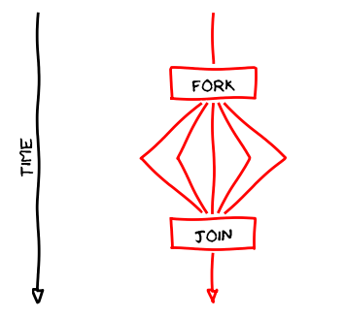
Number of Threads
You must configure the environment variable OMP_NUM_THREADS depending on your O.S.
This must be done before program execution. Once compiled, you don’t need to recompile. Don’t worry, you can decide the number of threads

Slide 29

Fork!

Slide 30
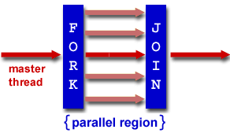
Fork-join model
Programs are executed sequentially, as a normal monoprocessor one until a fork instruction is reached
In this very moment, begins a “parallel” section. It means, really, that system creates as many threads as are specified by the environment or program

Slide 31
Fork-join model
ALL threads runs the same code
Once threads ends their execution, they “join” into a single thread again
Internal variables inside threads are disposed. Specification doesn’t says nothing about this memory

Slide 32
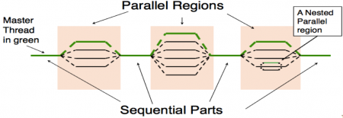
Fork-join model
More in detail:
Threads are not necessarily related to the number of actual cores
  Threads can be nested
  Number of threads can be increased/decreased as you need

Slide 33

Private and shared
OpenMP is designed for shared memory architectures, but of course there is important to share variables in many contexts
Variables declared before parallel section, will be shared among running threads
Variables created inside parallel section (or appropiately defined) are private in that context

Slide 34
Example 2
int privateX=0;
#pragma omp parallel
{ int sharedX=0;
privateX++;
sharedX++;
printf(“privateX %d sharedX %d\n”,
privateX,sharedX);
}

Slide 35
Example 2
int privateX=0;
#pragma omp parallel
{ int sharedX=0;
privateX++;
sharedX++;
printf(“Hello world priv %d share %d\n”,privateX,sharedX);
}
Variable privateX is actually shared between threads, while variable sharedX is private, it is, a copy is stored inside each thread. Run this example with 4,8,16,32 cores. Can you see a pattern?
Note: confusion was intentional

Slide 36
Example 2
OpenMP has the modifiers shared(vars) and private(vars)
Modify the example to have a for instruction that modifies a shared variable, like this
#pragma omp parallel shared(x)
for (i=0;i<100;i++)
x++;
And then run with 2,4 and 8 threads

Slide 37
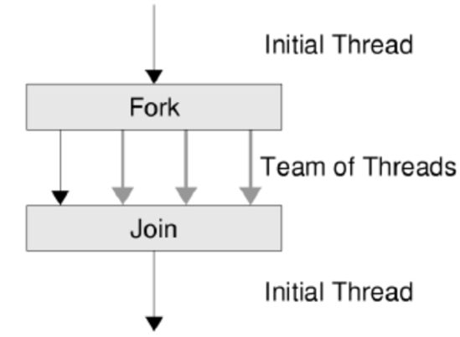
Execution order
Thread’s execution order is non deterministic. OpenMP specification doesn’t define any policy or special numbering for threads (except the master one: Thread 0).
Moreover, threads are intended to be really concurrent, so any thread can start/finish at any time after parallel section is reached.

Slide 38
Execution order
All threads but the master (numbered as Thread 0) are destroyed when all of them reaches the end of parallel section
You can’t do any assupmtion about memory allocation, order of creation nor order of destruction of threads.

Slide 39
Execution order
REMEMBER
You can’t do any assupmtion about memory allocation, order of creation nor order of destruction of threads.

Slide 40
Execution order
PLEASE REMEMBER !
You can’t do any assupmtion about memory allocation, order of creation nor order of destruction of threads.

Slide 41
Data parallelism
OpenMP implements data parallelism. This is particularly useful for problems where you want to run the same instructions over multiple pieces of data.
These pieces of data must be disjunct. But be careful: control over data is your responsibility as programmer
The most common use is when we deal with arrays or matrixes
for (i=start;i<end;i++)
x[i] = doSomething(a[i])

Slide 42

Remark
Many real-life problems can be modeled as a combination of functional and data parallelism.
Just splitting data to make threads deal with small portions seems not to be always the smartest approach

Slide 43
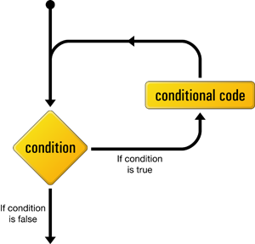
Data parallelism
OpenMP designers gave an special treatment for “for” instruction (“DO” instruction in Fortran)
So, programmers doesn’t need to change anything on their semantics: OpenMP handles everything (with certain restrictions)

Slide 44
Example 3
#include <stdio.h>
int main(char **argv,int argc)
{
#pragma omp parallel for
for (int i=0; i<N; i++)
printf(“ i value: %d \n“,i);
}

Slide 45
Remarks on parallel for
parallel for must be used just before the for instruction
No other variables but incremental one must be used
Incremental variable must not be modified inside the for instruction

Slide 46
Remarks on parallel for
If there are multiple for instructions, parallelism applies to the innermost
Each thread uses an internal copy of incremental variable

Slide 47
Example 4
float product(float* a, float* b, int N)
{ float sum = 0.0;
#pragma omp parallel for shared(sum)
for (int i=0; i<N; i++)
{ sum += a[i] * b[i]; }
return sum;
}
Compile & run, discuss the results

Slide 48

Parallel execution
This code works perfect in sequential case (as it is very simple). But, if you run it in many cores, you could get erroneous values most of times
Where is the bug?

Slide 49
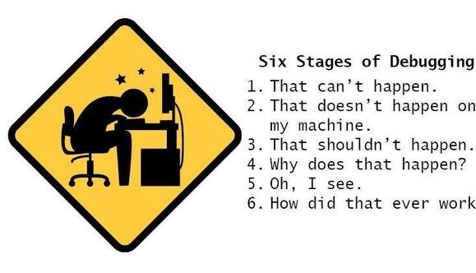
Parallel execution

Slide 50
Concurrency
A deeper sight shows that
sum += a[i] * b[i];
Does not prevent that two threads collide writing the variable “sum”
In fact, if there are many threads, collisions are almost sure
To avoid this, only one thread must access the variable

Slide 51

Critical Section
OpenMP has clauses that allows only one thread to execute specific parts of code
This part of code is called critical section and can be executed by only one thread, even if other lines of code are being executed

Slide 52
Example 5
float product(float* a, float* b, int N)
{ float sum = 0.0;
#pragma omp parallel for shared(sum)
for (int i=0; i<N; i++)
{
#pragma omp critical
sum += a[i] * b[i];
}
return sum;
}

Slide 53

Critical Section
Is there any problem within this solution?
#pragma omp critical
sum += a[i] * b[i];

Slide 54
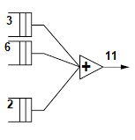
Reductions
The best way to avoid this performance degradation, is to keep private copies of the variable, and at the very end of computing, sum all of them
This is achieved in OpenMP with the clause
reduction(operator:variables)

Slide 55
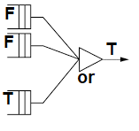
Reduction
With this clause, we do say to compiler: “please keep a private copy of X, initialize it, and apropriately combine all the private X’s at the end”
Operators can be: sums, divisions, logical operators, etc

Slide 56

Reduction
Inside parallel clause:
  Variables are initialized with neutral value depending on operation.
  Local copies are updated independently
  At end of clause, local copies are join together using operator

Slide 57
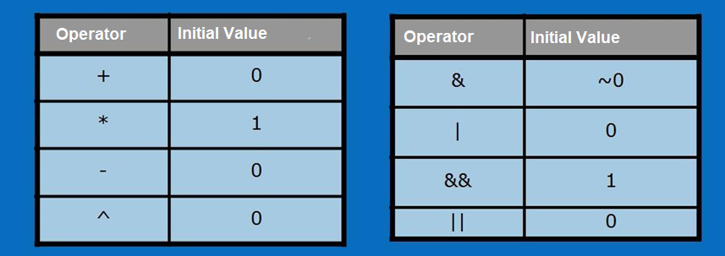
Reduction

Slide 58
Example 6
float product(float* a, float* b, int N)
{ float sum = 0.0;
#pragma omp parallel for shared(sum) reduction(+:sum)
for(int i=0; i<N; i++)
{ sum += a[i] * b[i];
}
return sum;
}

Slide 59

Comment on parallel for
Since matrixes operations are, by far, the most common parallel operation in Scientific Computing, parallel for clause is very important in terms of performance
You must be VERY CAREFUL about unexpected side-effects.

Slide 60
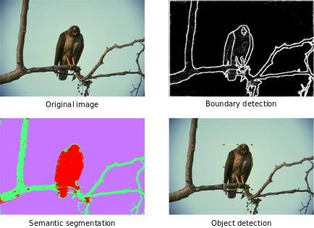
Load Balance
Not all the tasks derived from a parallel for will consume the same time. For instance, think about probabilistic algorithms or filters applied to images
In such cases, some threads will work harder than others

Slide 61

Load Balance
Suppose you have 12 tasks, whose times (in seconds) are these:
Time: {1, 3, 40, 30, 5, 6, 200, 100, 30, 1, 2, 150}
Total sequential time: 568 min
So, if you have two threads, these are the expected execution times:
Thread 0: {1, 3, 40, 30, 5, 6} = 85 min
Thread 1: {200, 100, 30, 1, 2, 150} = 483 min

Slide 62

Load Balance
Remember: execution time is as fast as the slowest thread into competition

Slide 63
Load Balance
However, if you have 3 threads, these are the times:
Thread 0: {1, 3, 40, 30} = 74 min
Thread 1: {5, 6, 200, 100} = 311 min
Thread 2: {30, 1, 2, 150} = 183 min
And 4 threads:
Thread 0: {1, 3, 40} = 44 min
Thread 1: {30,5, 6 } = 41 min
Thread 2: {200, 100 , 30} = 330 min
Thread 3: {1, 2, 150} = 153 min

Slide 64
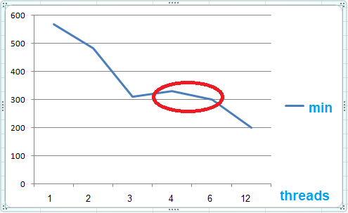
Load Balance
This is the time for different number of threads (worst time for each scenario)

Slide 65

Load Balance
A way to avoid load unbalance, is scheduling jobs
Threads can take dinamically as much work as they can deal with
This leads to more efficient execution. Think in tasks as a card dealer assigning jobs as threads ends its executions

Slide 66
Schedule clause
This clause indicates OpenMP to divide the N indexes among T threads in different ways.
schedule(static)
  Divides indexes into equal chunks of size N/T. Default
schedule(static, K)
  Assign chunks of size K using round robin method

Slide 67
Schedule clause
schedule(dynamic)
  Assigns ONE index to each Thread. As well as each Thread ends its execution, a new index is delivered
schedule(dynamic, K)
  The same as above, but with chunks of size K

Slide 68
Schedule clause
schedule(guided)
  Uses an exponential formula to decrease the size of chunk
schedule(guided, K)
  The same as above, but chunks starts with size K
schedule(runtime)
  Depends on the environment variable OMP_SCHEDULE

Slide 69

When do we use SCHEDULE?
STATIC: all tasks are similar on complexity and time execution
DYNAMIC: tasks are quite different in complexity or execution time. Usually, due to probabilistic behavior
GUIDED: when workload is variable but not so much, and we want planning time to be small.

Slide 70
Remark
EACH TIME you have an scheduler, somebody has to work coordinating threads
ALWAYS

Slide 71
Example 7
#pragma omp parallel for schedule (static, 8)
for( int i = start; i <= end; i += 2 )
{ if ( TestForPrime(i) )
gPrimesFound++;
}
Every thread will be assigned with sets of 8 indexes to work with, until all N sets are assigned.
N=(end-start)/threads

Slide 72
Example 7 part 2
#pragma omp parallel for schedule (dynamic, 10)
for ( int i = start; i <= end; i += 2 )
{ if ( TestForPrime(i) )
gPrimesFound++;
}
Each thread, at beginning, works with 10 indexes. Then, once each thread ends, is loaded with 10 more indexes until the total number is reached. It is no important to assign all threads with the same final number of indexes.

Slide 73
If clause
#pragma omp parallel for if ( n > 5000 )
for ( i= 0 ; i< n ; i++ )
{ x = (i+0.5)/n; area += 4.0/(1.0 + x*x);
} pi = area / n;
In this example, parallel section is called ONLY if variable n is greater than 5000. It avoids unnecessary calculations for small sets

Slide 74
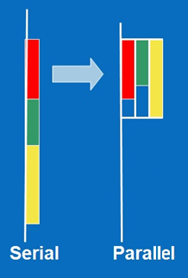
Functional parallelism
In many problems, we ask threads to perform different tasks. For instance, use different filters for the same input image
Lets imagine tasks as colours

Slide 75
Functional parallelism
There is the sections clause so each thread can perform its own code
#pragma omp parallel sections
{
#pragma omp section
redCode();
#pragma omp section
greenCode();
#pragma omp section
yellowCode();
}

Slide 76

Control clauses
A few control clauses allows programmers to decide more precisely the behavior of threads
For instance, you can block some threads because some conditions, or make all wait for some conditions

Slide 77
Single clause
This clause makes just one thread to execute some part of code. It is not as private, so only one executes during whole running
#pragma omp parallel
{
commonPart();
…
commonPart();
#pragma omp single
{
backup();
} // all threads waits here
moreCommonCode();
}

Slide 78
Master clause
All threads but MASTER skips this part of code
#pragma omp parallel
{
commonCode();
…
commonCode();
#pragma omp master
{
masterCode();
} if thread isn’t master, just skip this
modeCommonCode();
}

Slide 79
Remarks
Single and master clauses seems to have the same behavior, but there is an implicit barrier that makes the difference.

Slide 80
Barrier clause
Every thread waits until barrier is reached
#pragma omp parallel shared (A, B, C)
{ task1(A,B);
printf(“ALL finished task 1\n”);
#pragma omp barrier
task2(B,C);
printf(“Task 2 finished!!\n”);
}

Slide 81
OpenMP library
OpenMP has a set of library functions that helps to improve the usage of compiler clauses
These functions makes OpenMP more powerful and versatile, bringing programmer even more control over their programs

Slide 82

OpenMP library
omp_set_num_threads: sets the number of threads for an specified parallel section
omp_get_num_threads: takes the number of actual threads running

Slide 83
OpenMP library
omp_get_max_threads: gets the number of threads that will be created in the next parallel section
omp_get_thread_num: gets the threadID of any thread (0.. N-1). Is used to assign different instructions to each thread

Slide 84
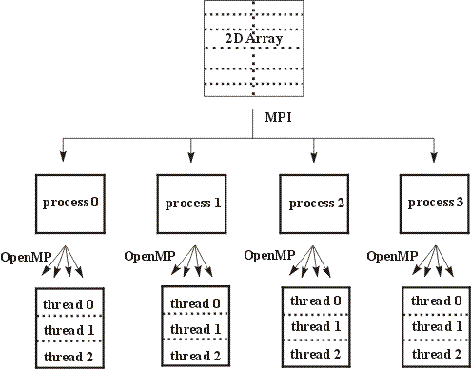
OpenMP – MPI
Modern architectures allows the mixing of OpenMP and MPI in the same programs!!

Slide 85
Example 8
#include <mpi.h>
#include <omp.h>
#include <stdlib.h>
#include <stdio.h>
int i; int node,numnodes;
Int size=32;
int main(int argc,char **argv)
{ MPI_Init(&argc,&argv);
MPI_Comm_rank(MPI_COMM_WORLD,&node);
MPI_Comm_size(MPI_COMM_WORLD,&numnodes);
MPI_Bcast(&size, 1, MPI_INT, 0, MPI_COMM_WORLD);
#pragma omp parallel
printf(" thread %d of %d inside node %d of %d\
nodes\n",omp_get_thread_num(),omp_\
get_num_threads(),node,numnodes);
MPI_Finalize();
}

Slide 86
Exercise 1
This code calculates π:
static long num_steps=100000;
double step, pi;
void main()
{ int i; double x, sum = 0.0;
step = 1.0/(double) num_steps;
for (i=0; i< num_steps; i++)
{ x = (i+0.5)*step; sum = sum + 4.0/(1.0 + x*x);
}
pi = step * sum;
printf(“Pi = %f\n”,pi);
}

Slide 87
Exercise 1
Use OpenMP to parallelize this code, and discuss:
  Which variables must be private or shared?
  Must be critical sections?
  If not, can you solve using other methods?

Slide 88
Exercise 2
Consider the following: search for an element within an unordered array. Suppose we have this very simple code
int i,found;
found=0;
for (i=0;(i<N) && (!found);i++)
if (a[i]==element) found=1;

Slide 89
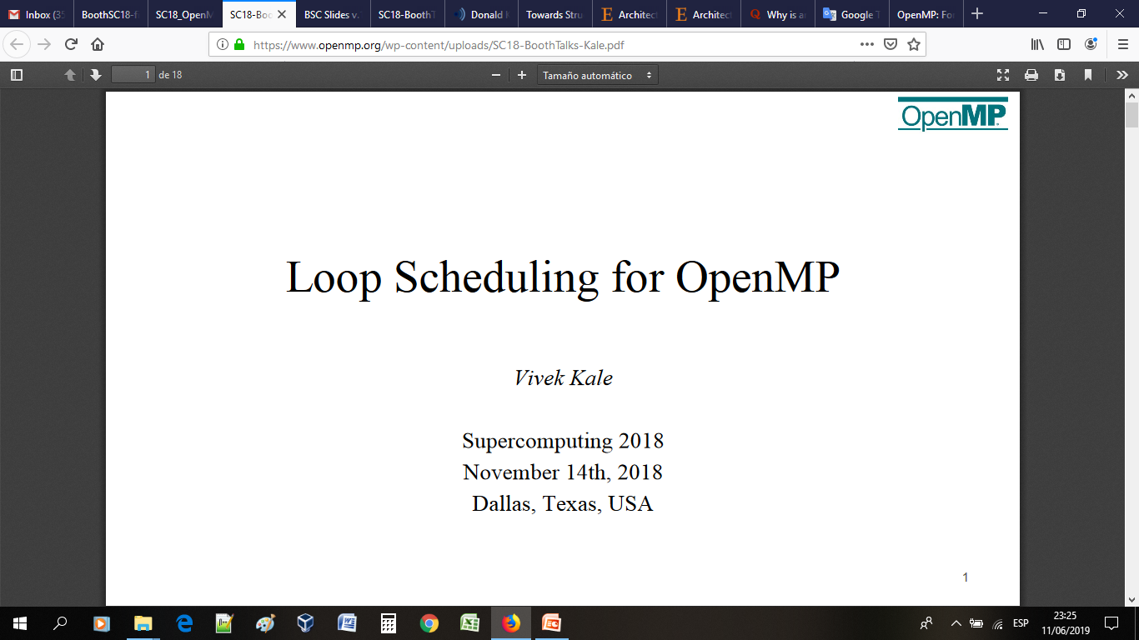
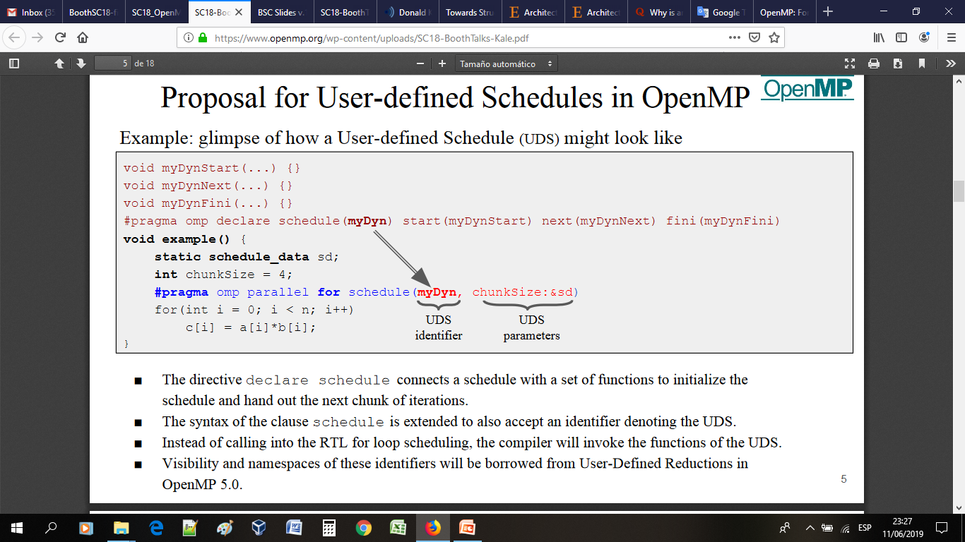
New Trends - UDS

Slide 90
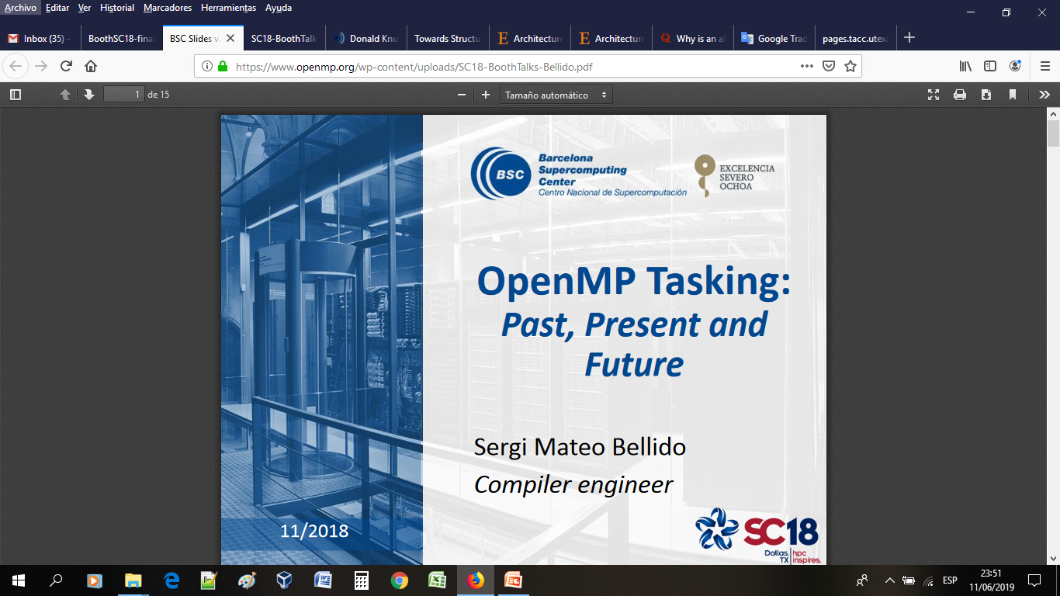
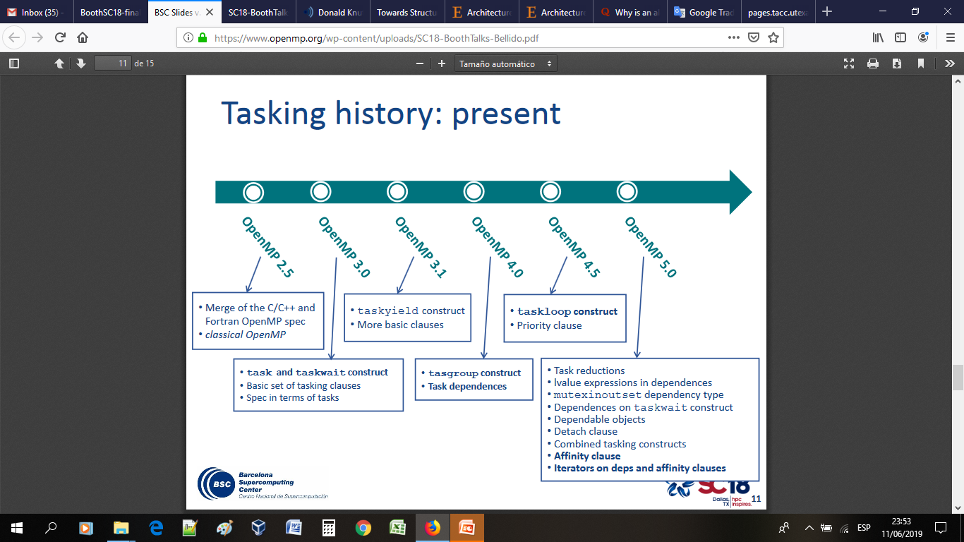
New Trends - Tasking

Slide 91
OpenMP Tutorial
Robinson Rivas Suárez
Universidad Central de Venezuela
Thanks for taking this tutorial!!
Robinson.rivas@gmail.com

